Slide 1
X User Interactive
Studying Application
Youssef Hassan / 19.12.2021

Slide 2
Executive Summary
Background
Since our App is at a very early stage, our team is interested in exploring opportunities in Student learning products. We interviewed 3 students on their needs, pain points, and how they use digital products to study.
Key Findings
Students have study throughout the day. They use their mobile apps primarily to study curriculum. Major products in the market may place too much emphasis on curriculum subjects. We identified opportunities to build a product with a focus on Interactive study experience.
Research Goal
The goal of this study is to explore ways to engage avid students to use familiar social media app environments, including customized Classrooms, and interactive user experience. I also wanted to identify factors that might encourage students to use mobile apps to study and explore the necessary needs that students might have.

Slide 3
Research Questions
Research Questions
[Needs]
  What is essential for engaging students to use a studying app?
  What are users current pain pointers?
  Do users really need another Studying app product?
[Behaviors]
  Do student currently use studying mobile apps?
  How do they interact with existing digital studying app products? (if at all?)
  How do users feel about existing studying mobile Apps products?

Slide 4
Participants
Recruiting
3 participants
slack: 1 randomly selected participant will be taken from slack’s FWD community page because this is the desired user persona demographic we want to achieve. We want to select users from this particular social media app because: 1) active users on slack will be more likely to use an app similar to the slack interface App, 2) active slack users are the desired user persona, and 3) slack’s FWD page has users that like being informed about topics related to studying. And the rest participants are my family members.
Selection: I will randomly select 1 slack user from my FWD slack community of over 1,000k. I will DM message him:
Hello {name}! I am doing a study on what attracts people to study via digital platforms. I would like to ask you a few questions about your interests on social media - even if you are not currently or have never used an app to study. This short conversation will take about 15 minutes. If you agree, I'd like to give you a shout out to the Slack page!
Participants
3 Adults
I want to target a different range of ages, because I would like to build my user persona characteristics, with age being one of the persona indicators.

Slide 5
Key finding #1
The significant user needs found within this study are:
1) 70% of readers have currently use a mobile app to study
The 2 apps used are: Zoom and Google Classroom
2) 75% of the participants enjoy the convenience of using a studying mobile app
“I prefer studying on google classroom because the zoom is expensive, and free rooms are limited all the time, except if i subscribe the premium”
“I used to like classroom in college, but now that I don’t need to go to college, I just use digital”
“I enjoy studying both digital and in school. I want to start my own studying library - so I record all my lectures.”
“digital is best for me - I don’t ask the instructor, so i can watch my records anytime and anywhere”

Slide 6
Key finding #2
The significant user behaviors found within this study are:
1) more than half the participants have agreed that it is easy to navigate the basis of studying apps
studying app students enjoy the ability to instantly have the actual experience
“I click the app on my phone, and it goes straight to my most recent classroom.”
  “I just open the app and it goes directly to the studying page. It’s super easy.”
studying app students study: after college, on weekends, on vacations, on waiting moments (dentist office, etc.), break time in school
  “I usually just study on the road. It’s an hour ride, and study it’s when I find the most time.”
  “It depends on the day, but I like studying on the weekends, or when I plan a nice vacation. I’ll finish a curriculum.”
  “I study when I have slow periods in school, or when I have time after school.
2) less than 70% of users are actively in the house, however
studying app users would like to have group interactions within a mobile studying community app
“I’ve been in a studying community before, however I feel off after college. I enjoyed it while I was using it. I would join again.”
  “I study really good curriculums, but It’s like watching a good movie/show and not being able to discuss it with anyone”
  “I’ve been looking to join/start a studying community! I just haven’t really found a community that wants to study what I like to study”

Slide 7
Recommendation/Next Steps
These findings have helped me re-shape the direction of developing the studying mobile app product. These are the new adjustments as follows:
Each studying session should be at least 1h and less than 2h
The mobile app should have built-in record
The mobile app will have collaborative study community components (i.e. shared records highlights, shared discussion topics for the end of the finals, shared classroom time schedules, etc.)
The mobile app will have a community so the students can study togather

Slide 8
Appendix

Slide 9
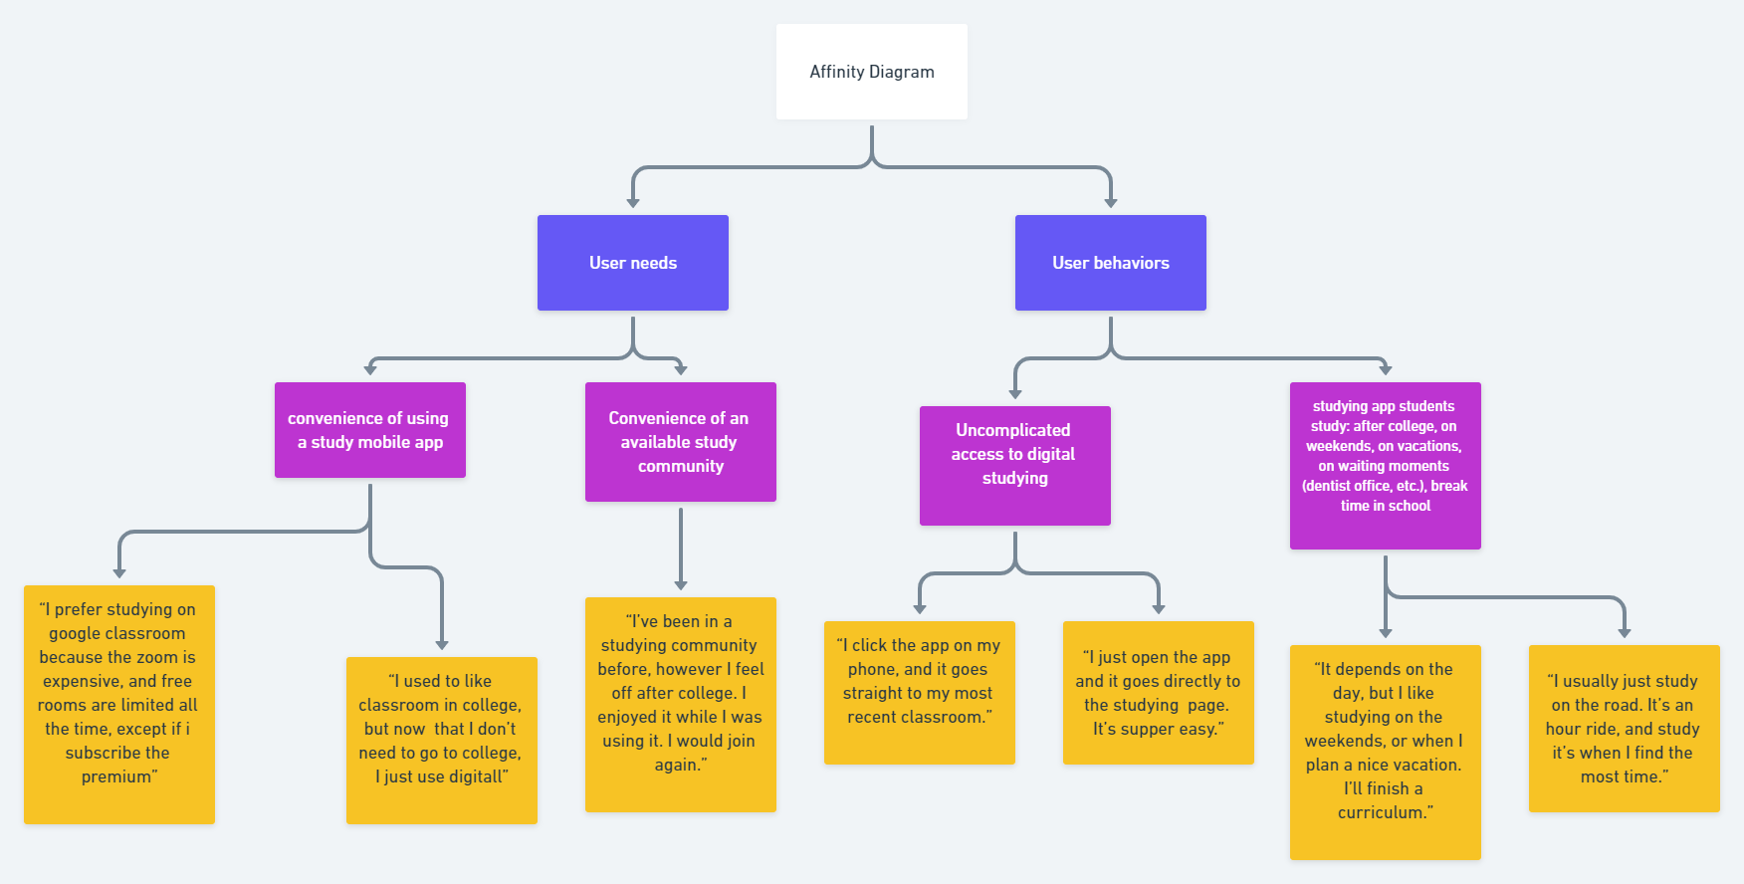
Affinity diagram

